Slide 1
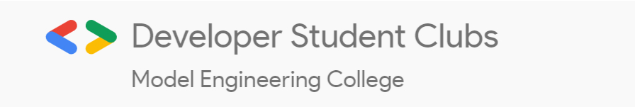
CSS POSITION
Learn to position your elements perfectly
Smriti Srinivas
Web team,DSC MEC

Slide 2

POSITIONING IN CSS
Sets how an element is positioned in a document
Positioning of an element can be done using left,right,top,bottom
But to set positions by these properties, we have to declare the positioning method at first

Slide 3
TYPES OF POSITIONING
STATIC
RELATIVE
ABSOLUTE
FIXED
STICKY

Slide 4
STATIC
Default position of all HTML elements
Element is positioned according to the normal flow of the document
NORMAL FLOW : Normal flow is the way in which the elements are arranged in web pages by the browser

Slide 5
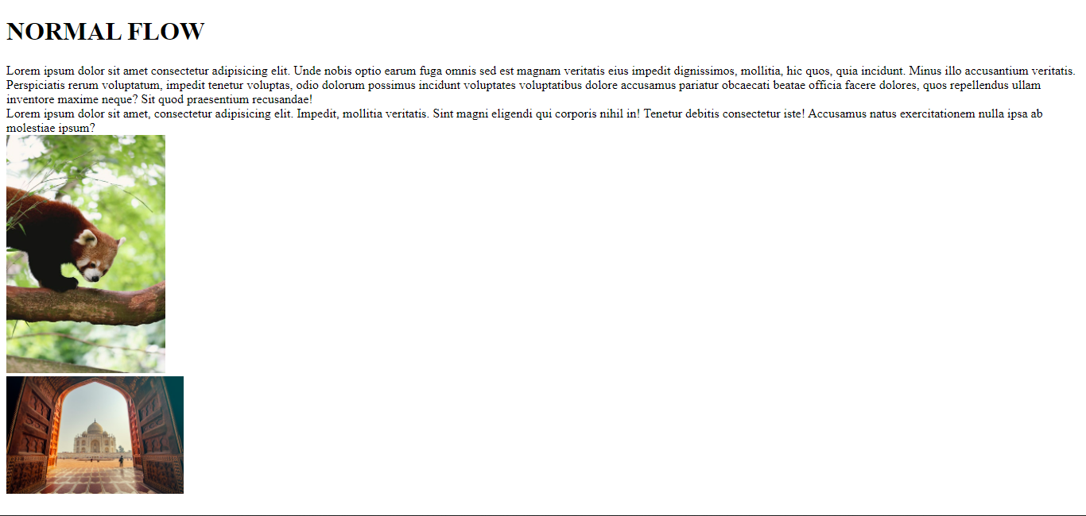

Slide 6
Top,bottom,left,right and z-index properties won’t have any effect once static property has been assigned

Slide 7
RELATIVE
The element is positioned with respect to its original position
The alignment is done from the original position of the element
Doesn’t affect the position of other elements
Element is not removed from the normal document flow

Slide 8
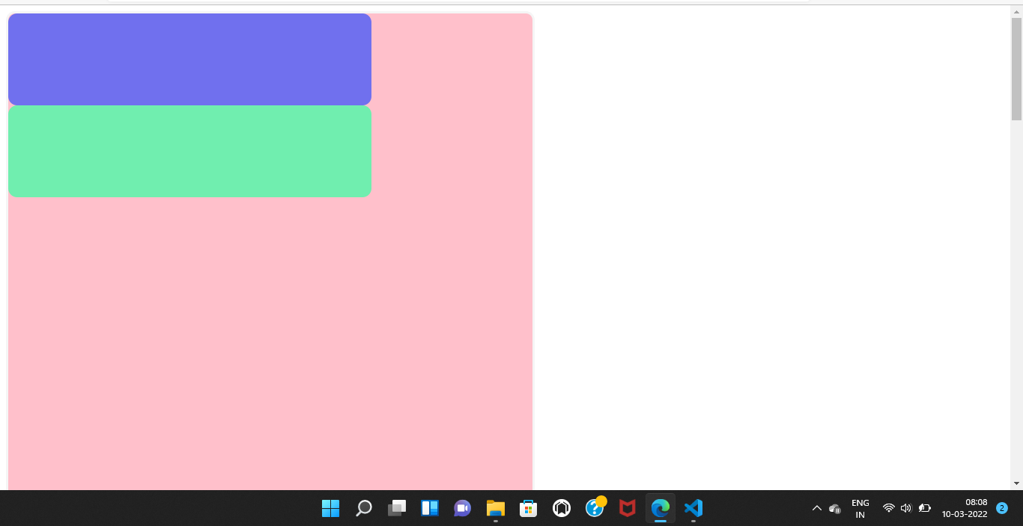
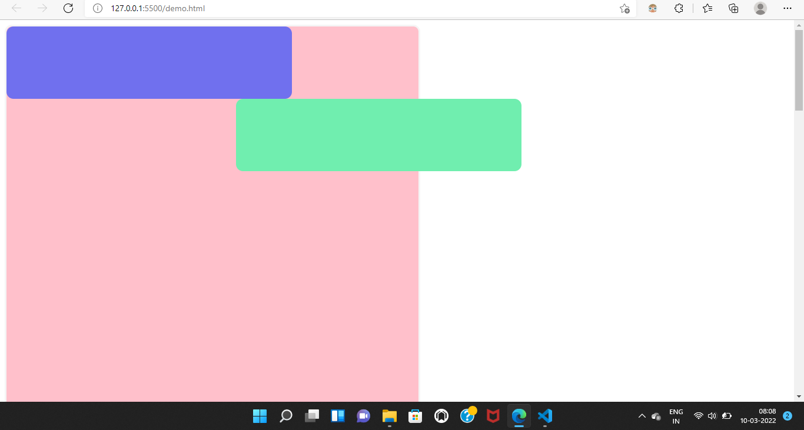
INITIAL POSITION
position: relative;
left:390px;

Slide 9
ABSOLUTE
Placed relative to the parent element
They are removed from the normal document flow
Will position an element relative to the parent only is the parent has been assigned position
If none of the parents were assigned, the element will be positioned according to the entire screem
Eg: Used to keep an image at the centre of a container always

Slide 10
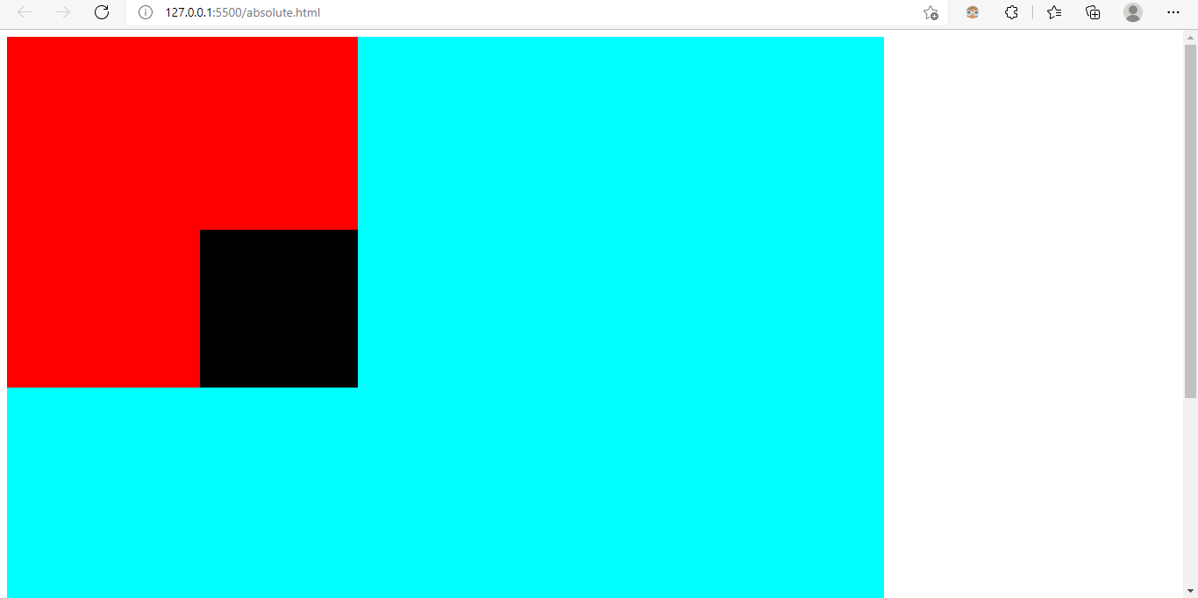
POSITIONED BOTTOM RIGHT WITH RESPECT TO RED BOX

Slide 11
FIXED
Element is positioned fixed to the viewport
Doesn’t take the parent container to consideration
The element will remain fixed at the specified position when when scrolled
Eg: Used to keep an icon always at the bottom-right corner

Slide 12
STICKY
Toggles between relative and fixed properties depending on the scroll position
Position remains relative in the beginning
But once, the user scroll past a certain point, it behaves as a fixed
Eg: Useful while positioning navigation bars

Slide 13
Z INDEX
Decides the stack order of an element
Doesn’t work with position:static
Element with greater z-index always comes at the front
Negative value of z-index indicates lower priority
Eg:- Useful when we need to show a text above an image

Slide 14
THANK YOU

